Slide 1
CPU Scheduling Algorithms
Tony Mai, Ryan Chen, Jiayi An

Slide 2
Introduction
Scheduling algorithms help dictate how much CPU time is allocated to processes and threads.
There are different types of CPU scheduling algorithms.
These scheduling algorithms can be preemptive or non-preemptive.
We will be focusing primarily on FCFS and Round Robin with a time quantum of 10.

Slide 3
Objective
Max CPU utilization [Keep CPU as busy as possible]
Fair allocation of CPU.
Max throughput [Number of processes that complete their execution per time unit]
Min turnaround time [Time taken by a process to finish execution]
Min waiting time [Time a process waits in ready queue]
Min response time [Time when a process produces first response]

Slide 4
Process Scheduling
Job Queue – Keeps all the processes in the system.
Ready Queue – Keeps a set of all processes residing in MM, ready and waiting to be executed.
Device Queue – processes which are blocked due to unavailability of an I/O device.

Slide 5
Schedulers
Long-Term Scheduler – Admits a program into system for process.
Short-Term Scheduler – Changes a process from ready to running state.
Medium-Term Scheduler – Removes process from memory.

Slide 6
Times used by the Algorithm
Arrival Time: Time at which the process arrives in the ready queue.
Completion Time: Time at which process completes its execution.
Burst Time: Time required by a process for CPU execution.
Turn Around Time: Time difference between completion time and arrival time.
Waiting Time: Time difference between turn around time and burst time.

Slide 7
First Come First Serve (FCFS)
Simplest scheduling algorithm that schedules according to arrival times of processes.
Jobs are executed on first come, first serve basis.
Short processes in the back may have to wait for longer processes in the front.
Based on a queue, FIFO.
Non-preemptive.

Slide 8
Round Robin
Each process is assigned to a fixed time in a cyclic way.
A fixed time called a quantum.
Every process gets an equal share of the CPU.
If the time quantum is a large large number, it may act the same as FCFS.
If the time quantum is too small, it will cause a lot of switches between processes.
Preemptive

Slide 9
Shortest Job Next
Processes with the shortest service time is first.
Non-preemptive
May cause starvation
Best approach to minimize the waiting time

Slide 10
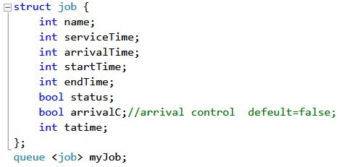

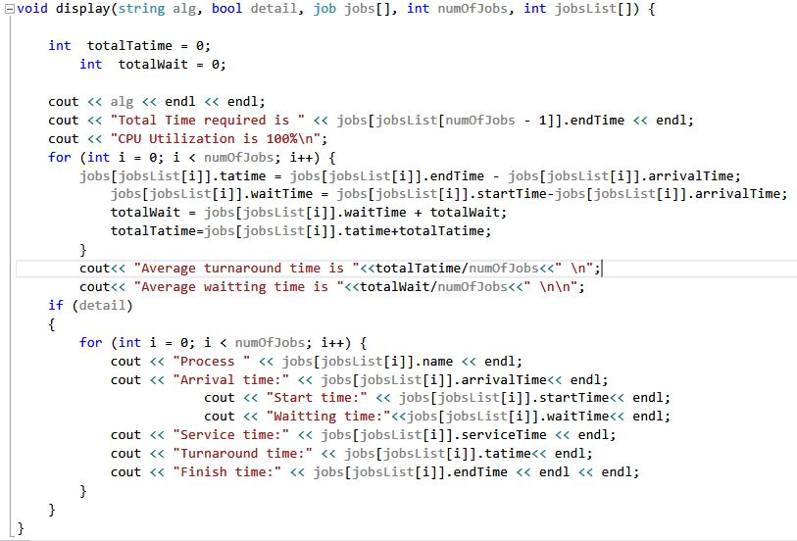
Our Struct, Display Method, and Input Data

Slide 11
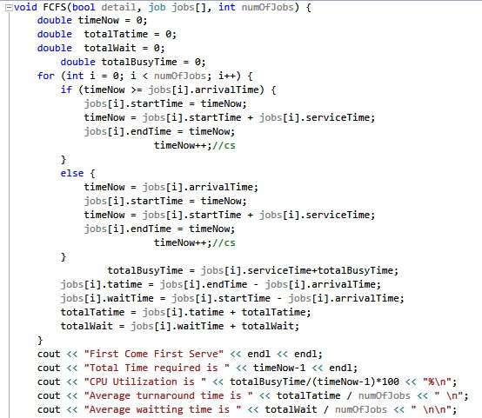
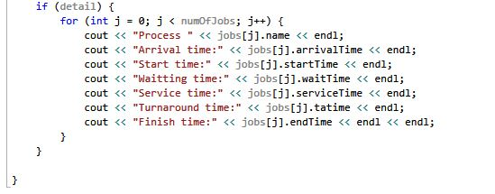
First Come, First Serve Method

Slide 12
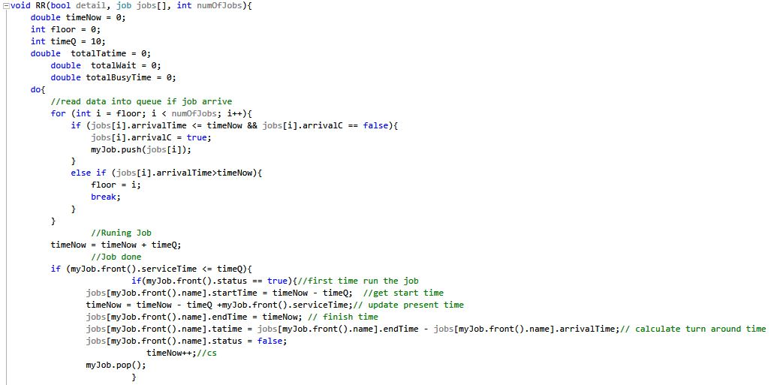
Round Robin Method

Slide 13
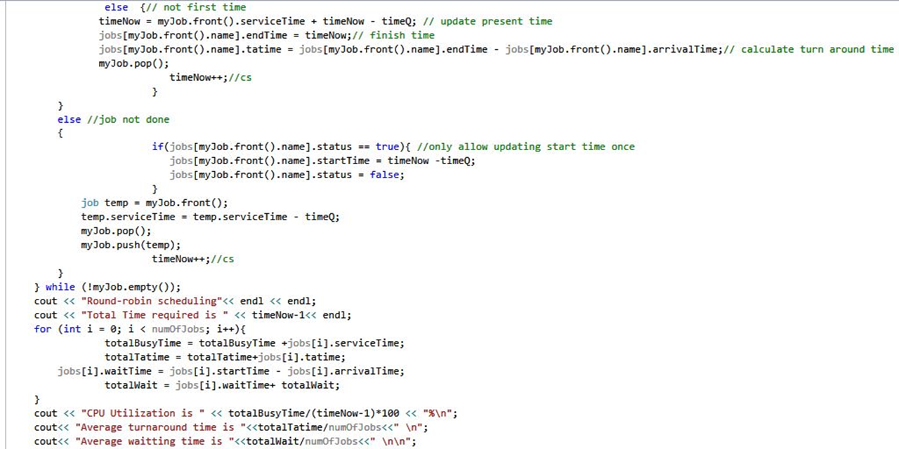
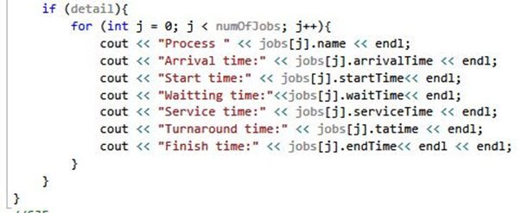
Round Robin Method Cont.

Slide 14
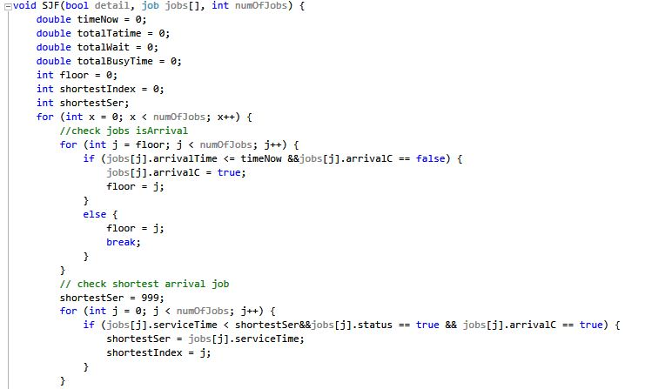
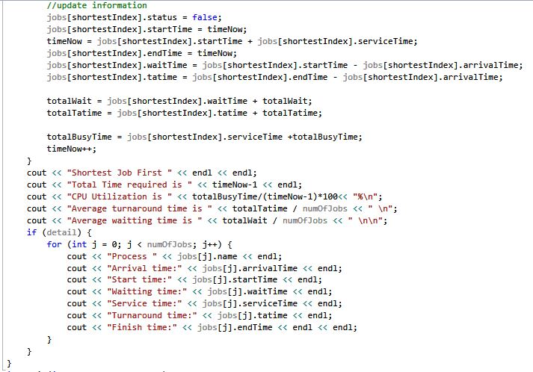
SJN Method

Slide 15
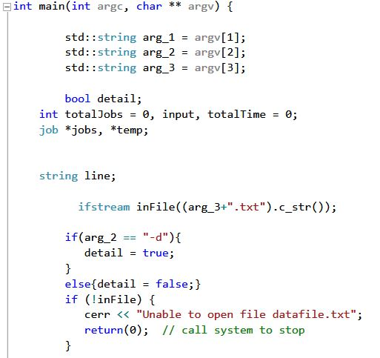
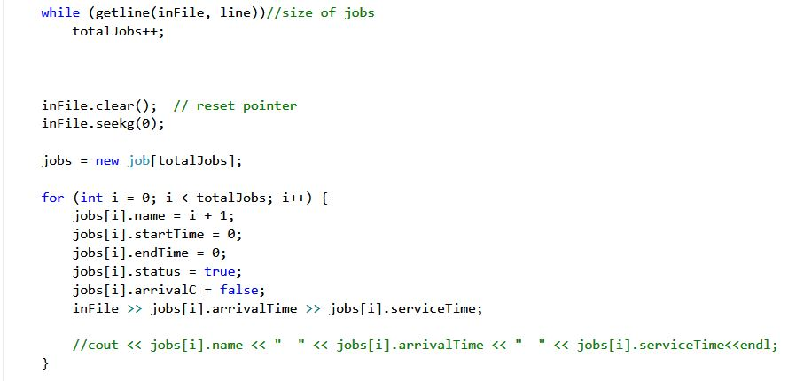
Main

Slide 16
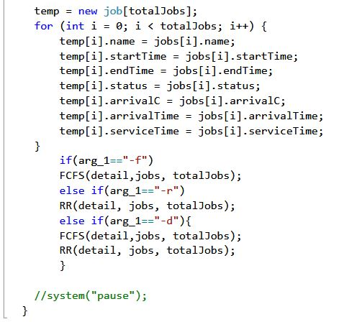
Main Cont.

Slide 17
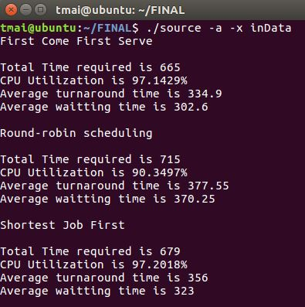
Output

Slide 18
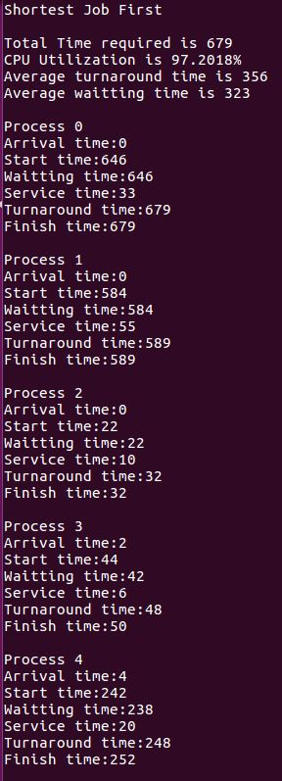
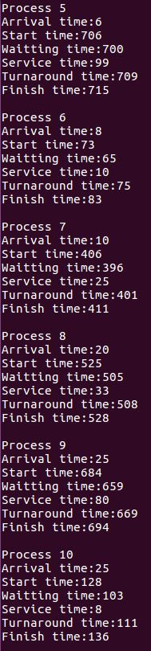
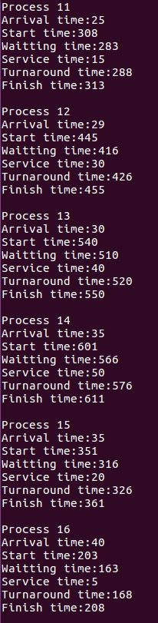
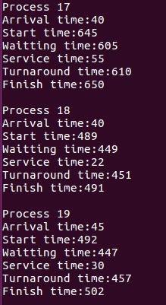
Output Detailed - SJN

Slide 19
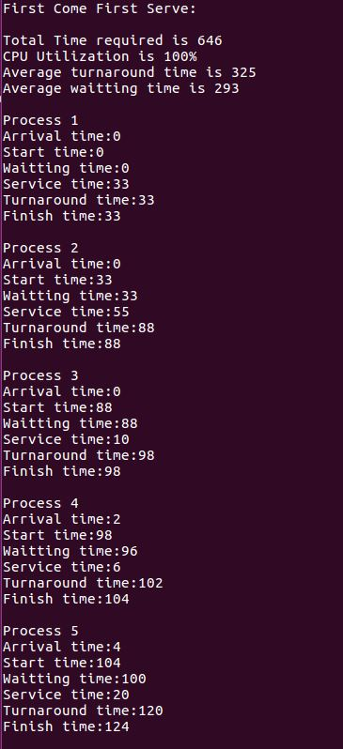
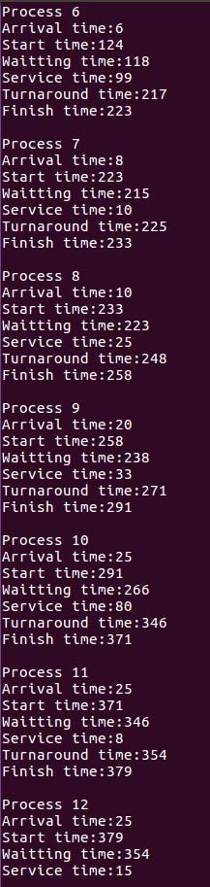
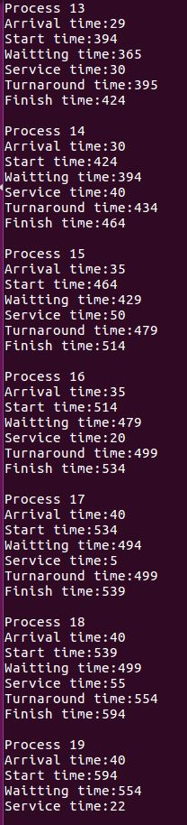
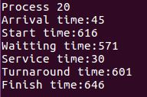
Output Detailed - FCFS

Slide 20
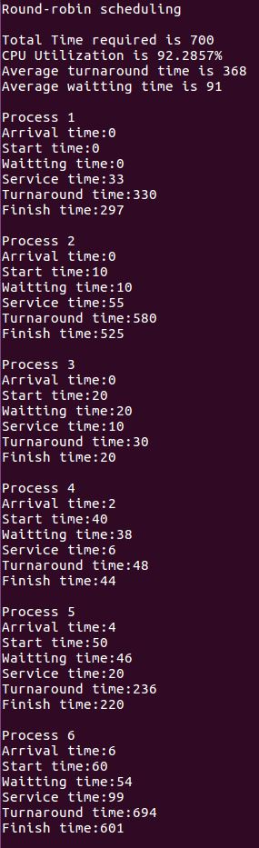
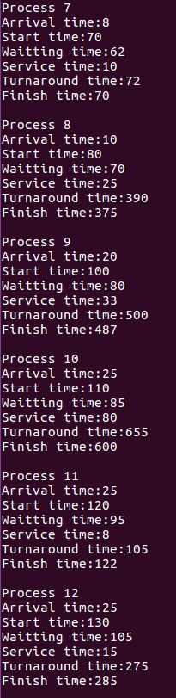
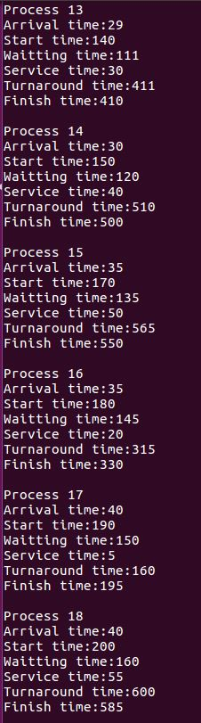
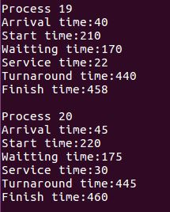
Output Detailed – Round Robin

